Slide 1

Module5
Numbers1-12
Unit1 How many?

Slide 2




What colour is it ?

Slide 3


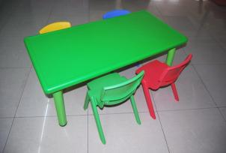
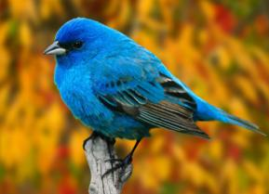
It’s a ……

Slide 4



It’s a ……

Slide 5

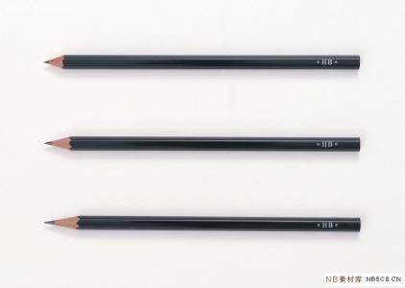

PPT模板：www.1ppt.com/moban/ PPT素材：www.1ppt.com/sucai/
PPT背景：www.1ppt.com/beijing/ PPT图表：www.1ppt.com/tubiao/
PPT下载：www.1ppt.com/xiazai/ PPT教程： www.1ppt.com/powerpoint/
资料下载：www.1ppt.com/ziliao/ 范文下载：www.1ppt.com/fanwen/
试卷下载：www.1ppt.com/shiti/ 教案下载：www.1ppt.com/jiaoan/
PPT论坛：www.1ppt.cn PPT课件：www.1ppt.com/kejian/
语文课件：www.1ppt.com/kejian/yuwen/ 数学课件：www.1ppt.com/kejian/shuxue/
英语课件：www.1ppt.com/kejian/yingyu/ 美术课件：www.1ppt.com/kejian/meishu/
科学课件：www.1ppt.com/kejian/kexue/ 物理课件：www.1ppt.com/kejian/wuli/
化学课件：www.1ppt.com/kejian/huaxue/ 生物课件：www.1ppt.com/kejian/shengwu/
地理课件：www.1ppt.com/kejian/dili/ 历史课件：www.1ppt.com/kejian/lishi/
one
two
three
four
Notes:
PPT模板：www.1ppt.com/moban/ PPT素材：www.1ppt.com/sucai/
PPT背景：www.1ppt.com/beijing/ PPT图表：www.1ppt.com/tubiao/
PPT下载：www.1ppt.com/xiazai/ PPT教程： www.1ppt.com/powerpoint/
资料下载：www.1ppt.com/ziliao/ 范文下载：www.1ppt.com/fanwen/
试卷下载：www.1ppt.com/shiti/ 教案下载：www.1ppt.com/jiaoan/
PPT论坛：www.1ppt.cn PPT课件：www.1ppt.com/kejian/
语文课件：www.1ppt.com/kejian/yuwen/ 数学课件：www.1ppt.com/kejian/shuxue/
英语课件：www.1ppt.com/kejian/yingyu/ 美术课件：www.1ppt.com/kejian/meishu/
科学课件：www.1ppt.com/kejian/kexue/ 物理课件：www.1ppt.com/kejian/wuli/
化学课件：www.1ppt.com/kejian/huaxue/ 生物课件：www.1ppt.com/kejian/shengwu/
地理课件：www.1ppt.com/kejian/dili/ 历史课件：www.1ppt.com/kejian/lishi/

Slide 6




five
5+1=?
six
eight

Slide 7

seven

Slide 8


eight

Slide 9

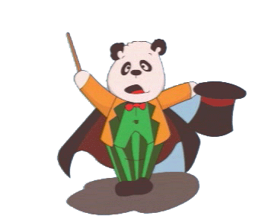
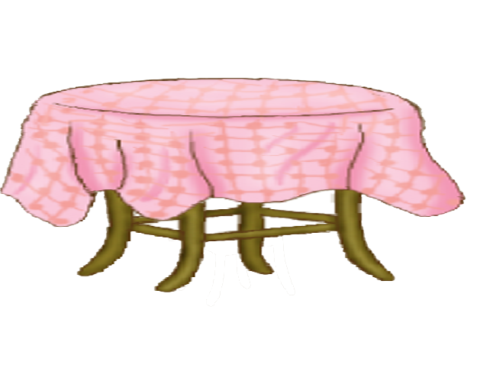
GUuess:
How many ?

Slide 10


O n e.

Slide 11

T h r e e.

Slide 12
F i v e.

Slide 13

How many?
?
seven

Slide 14

T w o.

Slide 15

How many?
?
eight

Slide 16

F o u r.

Slide 17

How many?
?
six

Slide 18

8
6
2
7
5
1
3
4

Slide 19
I can say !
1+2=？ 2+4=？
3+2=？ 2+5=?
1+1=? 3+4=?
6+2=?

Slide 20

C h a n t
How many? How many? One. One. One.
How many? How many? Two. Two. Two.
How many? How many? Three. Three. Three.
How many? How many? Four. Four. Four.
How many? How many? Five. Five. Five.
How many? How many? Six. Six. Six.
How many? How many? Seven. Seven. Seven.
How many? How many? Eight. Eight. Eight.

Slide 21

Homework:
Count the number from one to eight.
（从一数到八）
Tell your parents some telephone numbers.
(用英文告诉家长自己家和朋友家的电话号码 )

Slide 22



Thank you

